Slide 1
DataColada[60] Appendix.
Additional examples of erroneously selected tests results by Motyl et al.

Slide 2
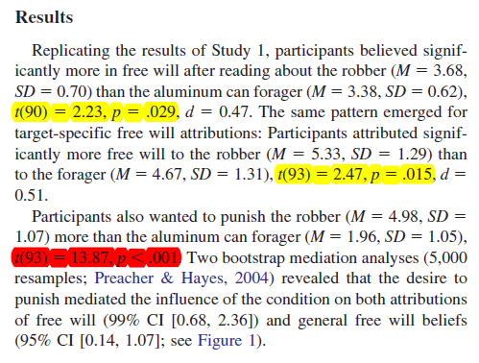
Extra Example 1
Original hypothesis
Reading about robbery will increase belief in free will
Relevant test
Free will in robbery vs control condition (p=.029)
Wrongly selected by JPSP authors
People want to punish robbers (p= .00000000000000000000000228)
Correct.
These test hypothesis of interest.
Incorrect.
The JPSP authors selected this test.
Notes:
Original article:
Clark, C. J., Luguri, J. B., Ditto, P. H., Knobe, J., Shariff, A. F., & Baumeister, R. F. (2014). Free to punish: A motivated account of free will belief. Journal of personality and social psychology, 106(4), 501.

Slide 3
Extra Example 2
Original hypothesis
Facing decisions with similar options increases belief in fate
Relevant test
Does belief in fate differ cross conditions? (p=.057)
Wrongly selected by JPSP authors
Are similar options similar? (p= .00000000000000000021)
Incorrect.
The JPSP authors selected this test.
Correct.
They should have selected this one
Notes:
Original article:
Tang, S., Shepherd, S., & Kay, A. C. (2014). Do Difficult Decisions Motivate Belief in Fate? A Test in the Context of the 2012 US Presidential Election. 25(4) 1046-1048.

Slide 4
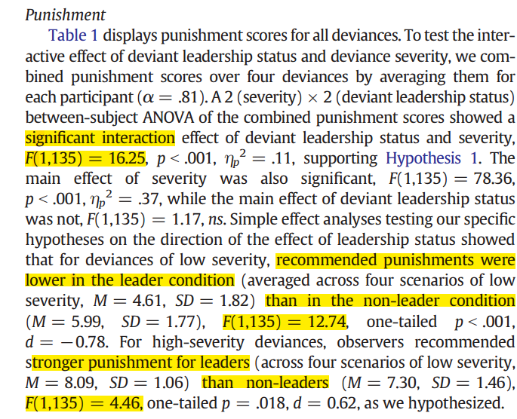
Extra Example 3
Original hypothesis
H1: low severity wrongs: leaders are punished less.
H2: high severity wrongs: leaders are punished more.
Relevant test: Two simple effects.
Low severity: leaders punished less (p=.0005)
High severity: leaders punished more (p=.0366)
Wrongly selected by JPSP authors
Interaction: severity*leader (p=.00009)
Incorrect.
The JPSP authors selected the interaction.
Correct.
They should have selected both simple effects
Notes:
Original article:
Tang, S., Shepherd, S., & Kay, A. C. (2014). Do Difficult Decisions Motivate Belief in Fate? A Test in the Context of the 2012 US Presidential Election. 25(4) 1046-1048.

