Slide 1
Could you repeat the question please?
SESP 2014 – Friday October 3rd
Uri Simonsohn

Slide 2
Question
Statistics
Data needs

Slide 3
Question
New Statistics
Data needs

Slide 4
New Question
New Statistics
Data needs

Slide 5
New Question
New Statistics
Much more Data needed

Slide 6
Question
Statistics
Data needs

Slide 7
Question
Bayesian Statistics
Data needs

Slide 8
Unclear Question
Bayesian Statistics
Data needs

Slide 9
Unclear Question
Bayesian Statistics
(Slightly more) Data needed

Slide 10
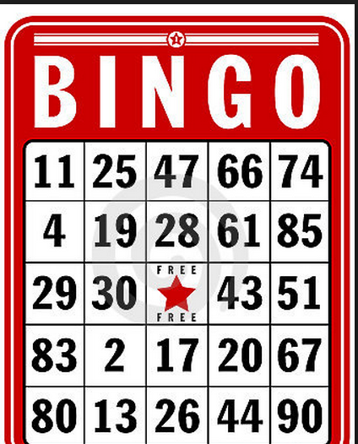
What question are you interested on?

Slide 11
Results
Control: 7.12 seconds
Bingo: 8.44
Bingo: 7.66
Bingo: 11.08
Bingo: 7.88
Bingo: 8.24
Bingo 8.24 seconds
p = .079
p = .0001
p = .0000001
p = .049
p = .0079
Notes:
This slide makes people realize we don’t care if the effect was 1 or 2 or 3 seconds, but we do care what the p-value was.

Slide 12
Our theories are about existence of effects
Our questions are about existence of effects
p-value: tool that informs existence of effect

Slide 13
Oh yeah? Null is always false!
Big N → anything**
Do we really care if with N=10,000:
Control: 7.12 seconds
Bingo: 7.16 seconds
p<.01?
Answer 1: Maybe!
Answer 2: Big N → not everything is **

Slide 14
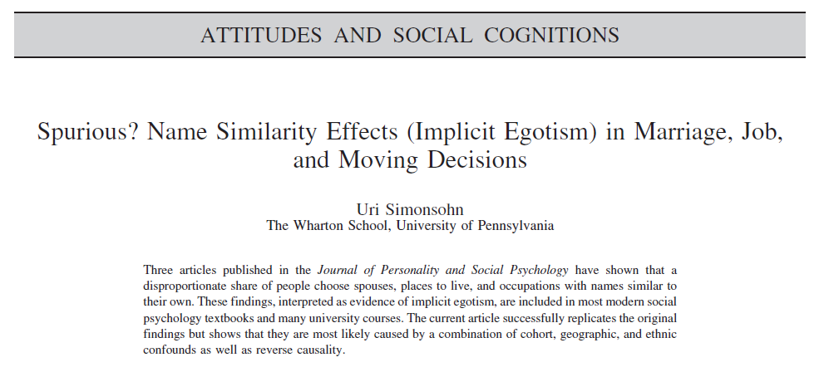
Simonsohn (2011)
N=12.8 million
February 2nd birthday
Live in 2nd avenue?
p = .74

Slide 15
Oh yeah? Null is always false!
Big N → anything**
Do we really care if:
Control: 7.12 seconds
Bingo: 7.16 seconds p<.01
Answer 1: maybe!
Answer 2: Big N → not everything is **
Answer 3: We don’t have big Ns!

Slide 16
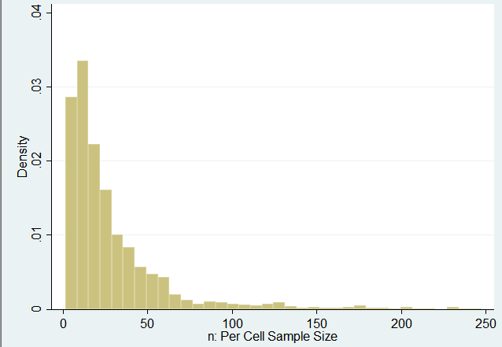
Sample Size in Psych Science 2003-2010
Median: n=19

Slide 17
When is N “too big” for p-values?
I work near wealthy lab
N<500
96th percentile
In a 2x2 design
80% power for d=.5 (!)
Notes:
\

Slide 18
Wait
…If lab can barely tell you if d=0 or not.
Say we did care about effect size
How much would we learn?

Slide 19
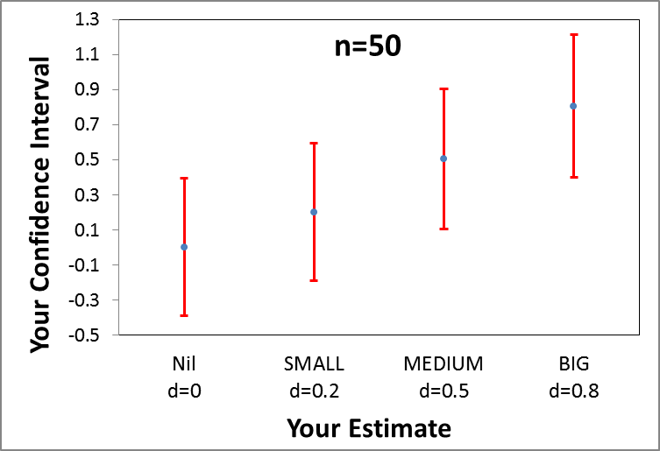
http://datacolada.org/2014/05/01/20-we-cannot-afford-to-study-effect-size-in-the-lab/

Slide 20
Lab studies are never too big for p-values
However…
They are always too small for confidence intervals

Slide 21
If we have a p-value question And give a CI answer. What happens?
Case study: Bootstrapping & mediation
If p=.049
“The confidence interval does not include 0”
If p<.0001
“The confidence interval does not include 0”
Confidence intervals have reduced information

Slide 22
What about Bayesian?

Slide 23
Recall:
Question
Statistics
Data needs

Slide 24
Recall:
Question
Bayesian Statistics
Data needs

Slide 25
Recall:
Unclear Question
Bayesian Statistics
Data needs

Slide 26
Recall:
Unclear Question
Bayesian Statistics
(Slightly more) Data needed

Slide 27
Bayesian Hypothesis Testing
Very nice approach
Are data more compatible with null or alternative?
But
Which alternative hypothesis?
What’s the question?
Psych Bayesians (so far)
“default” alternative
Null: d=0
Alternative: d~N(0,1)

Slide 28
Three Problems with Default Alternative
Problem 1: Who asked that question?
Problem 2: If we ask that question
Equivalent to p-value with α <.01
→Slightly more data
Problem 3: Answer changes (a lot) with o other alternative
Null: d=0
Alternative 1: d~N(0, 1)
Alternative 2: d~N(0, .5)
Alternative 3: d~N(0, .25)
Same data, different answer.
Not clear which it is we are asking
Notes:
Note: the equivalence of default Beyesian with alpha=.01 is obtained for sample sizes within the range typically run in psychology. For much larger samples a Bayes factor of 3 implies a lower p-value.
A nice example is the most recent verbal overshadowing RRR replication in Perspectives. The data “support” the null using N(0,1) as the alterantive, but most readers of the paper would concoude the data support the alternative.
All we need to do to conclude that is change the alternative to d~N(0,.1)

Slide 29
Last Slide
Question → Stats
Does effect exist in the lab? → p-value
That may be the wrong question
Let’s debate that
Be explicit about consequences
Can we study our own thing?
Leave the lab?
Go Within-Subject?
Research other things?

